Slide 1

The Rady School of Management
MGT 167 • Winter 2024 Social Entrepreneurship: Doing Well by Doing Good
Wednesday, February 14

Slide 2
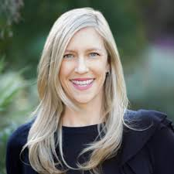
Feedback from Monday, 12 Feb.
+++++++ Heidi Patel
An insightful guest speaker!
Heidi is an incredibly smart, inspiring and well-spoken woman.
I like how she engaged her audience to make them think and keep them interested.
Interesting to know that women will control 2/3 wealth in future!
As a male, Heidi Patel was my favorite guest speaker. Very informative and passionate about her cause.
Presentation really helped me understand how to analyze an investor’s values for impact.
It’s inspiring to hear from people who love what they do.
She made a real case for Social Entrepreneurship.
Hearing how profitable the impact sector is…that inspires me.
The impact mapping is a very useful tool to think about personal investments– I think I’ll use this now!

Slide 3
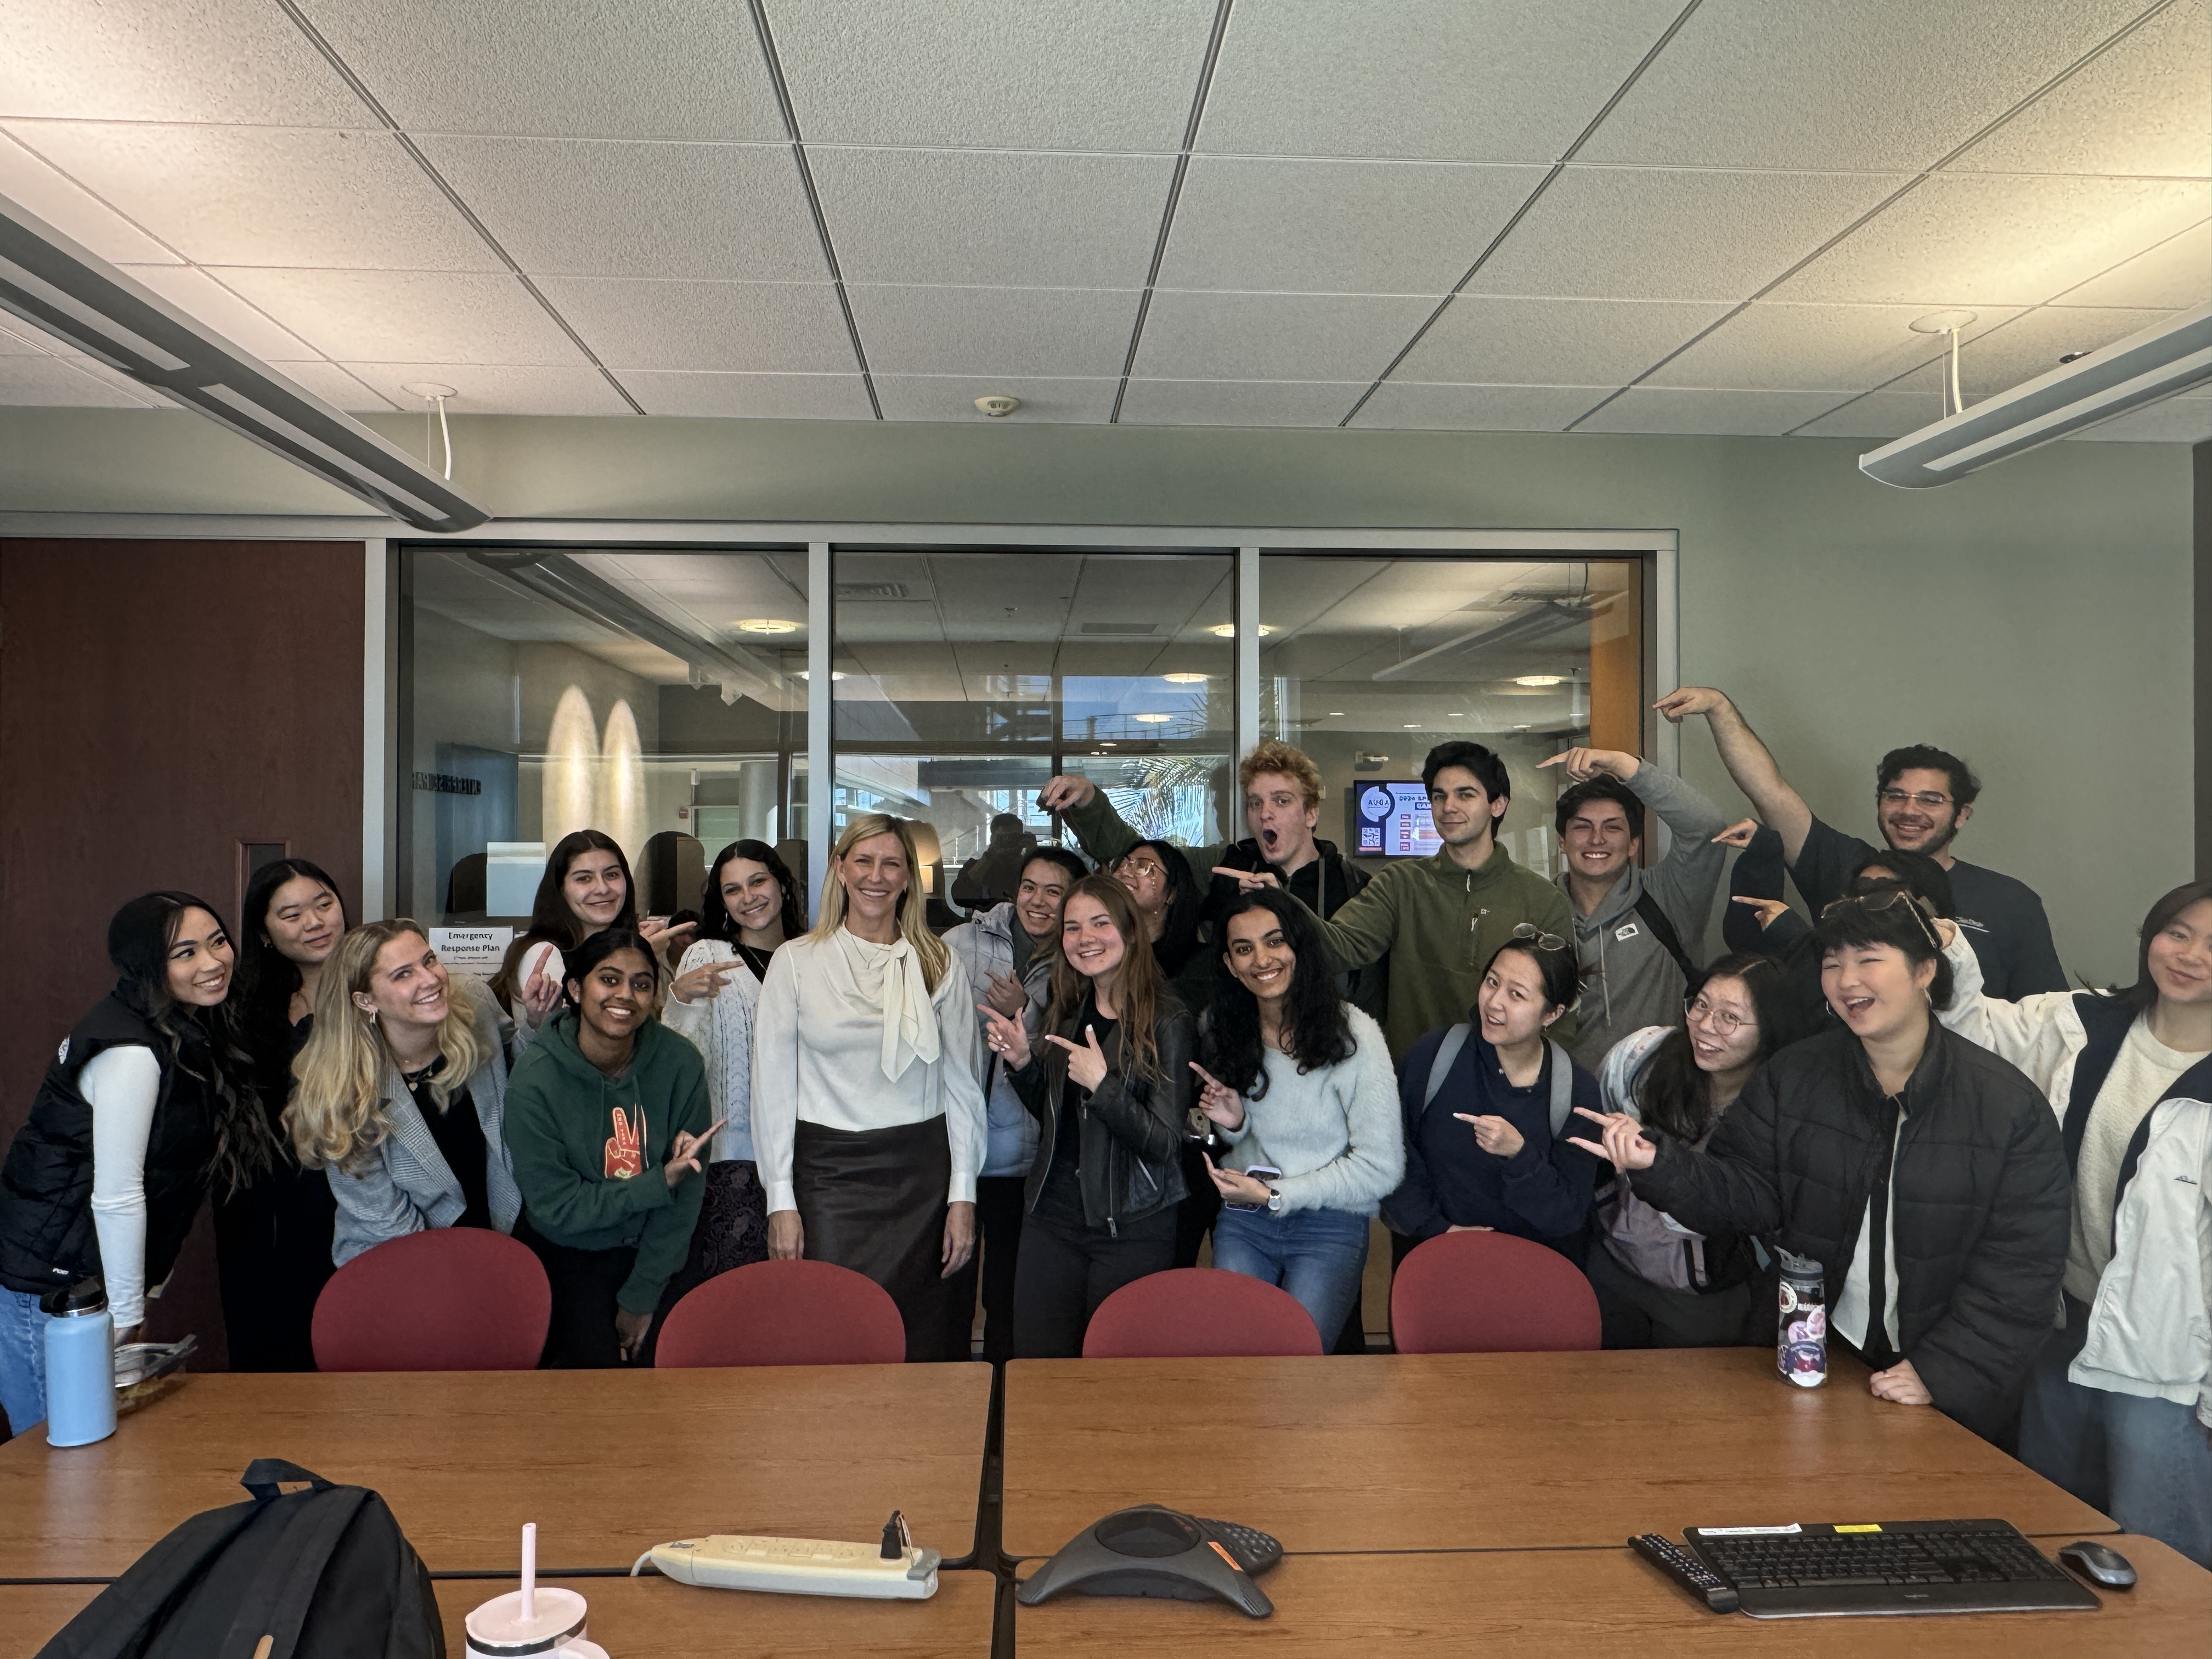
Brown Bag participation… a new record!

Slide 4
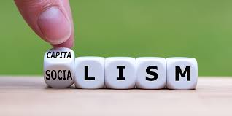
ESG
Environmental
Social
Governance (corporate)
Investing strategies should consider ESG issues.
Used since UN-sponsored report, “Who Cares Wins” (2004). Contrasts with Milton Friedman’s doctrine “The Social Responsibility of Business is to increase its profits.” (1970)
Stakeholder v. Shareholder Capitalism

Slide 5

Team leaders: prepare to brief for Vote on Passion pitches
Yoga, Mindfulness
Pets
Sports
Cooking
Food Waste

Slide 6
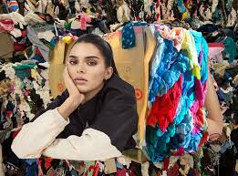
Tip: if you haven’t done your homework…
Out of Style: Will Gen Z ever give up its dangerous love of fast fashion?
Sirin Kale, The Guardian: 6 Oct 2021

Slide 7

(4) Passion pitches
Global warming
Education
Music Art Dance
Fast Fashion

Slide 8
Vote on passion teams
Yoga: Health and Well-Being
Food
Fast Fashion
Pets
Music, Dance, Arts
Global Warming
Education
Sports
Cooking

Slide 9
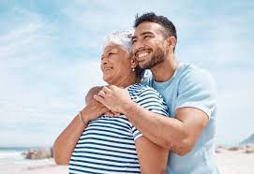
Video in lieu of final exam. due Sunday, March 3 if you miss the deadline, you take the comprehensive final exam on March 13
Interview your grandparent or parent
After the interview, create your 4-min. video summary
Introduce yourself, date, place and length of interview
Tell a story!
Critical editing, photos
Conclusions
Was this a worthwhile substitute for traditional final exam?
Notes:
great

Slide 10
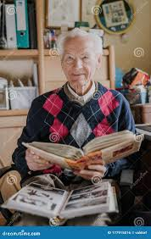
Video in lieu of final exam. due Sunday, March 3 if you miss the deadline, you take the comprehensive final exam on March 13
Process
Explain the assignment to your family member.
Make an appointment.
Allow them to prepare.
Ask to see their photos, scrapbooks, memorabilia.
Do not tape or video the interview. Minimize taking notes. Make it authentic.
Eyeball-to-eyeball engagement. Avoid interruptions. OK to go back for clarification after your interview.
Include a photo of you together, somewhere in video.
Share MGT167 lessons during the conversation. Share your own passion.
Ensure you have proper equipment to make a quality recording.
Prepare as if this is “practice” for a video job interview.
Use ZOOM best practices.

Slide 11
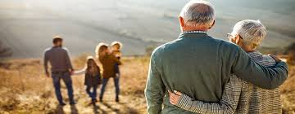
Video in lieu of final exam. due Sunday, March 3 if you miss the deadline, you take the comprehensive final exam on March 13
Suggested questions
When you were my age, what was your passion? What inspired you? What concerned you? What were the current world events?
How did you express your passion? What happened? Was the issue “fixed?”
If you were my age again, what would be your passion now?
“Tell me a story about…”
“Tell me more about…”
…is a great way to reboot

Slide 12
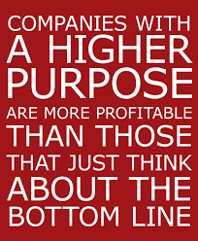
Revised syllabus will be posted this weekend
Check for updated assignments
Wednesday, Feb. 21
Steve Fambro, Co-CEO Founder Aptera
Quiz #3
Hosts: Sofia, Daniel, Matean… “stay behind”
Monday, Feb. 26
Emerging Fourth Sector

Slide 13
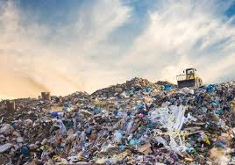
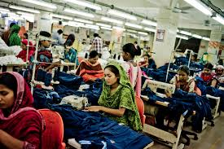
Purpose Beyond Profit: Fast Fashion
The Ugly Truth
The True Cost
Out of Style: Will Gen Z ever give up its dangerous love of fast fashion?

Slide 14
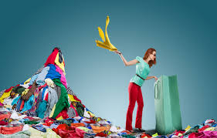

Small group discussion
Watch Choice:
The Ugly Truth about Fast Fashion Patriot Act: Hasan Minhaj Netflex (29 min)
or
The True Cost Documentary (1 hr.32min)
What did you learn from watching these videos?
Will it impact your future purchasing decisions?
What are your thoughts about Greenwashing?

Slide 15


Networking Term Paper due midnight Tuesday, Feb. 27

Slide 16
Networking exercise
Your journal is your essay
In-person or Zoom interview with someone you don’t already know
Author, philanthropist, celebrity, your choice
Social Entrepreneur from readings
NTE 2 pages (+attachments OK)
15% grade (term paper)
Thank you note, stamped ready to post
OK to partner with classmate, submit same paper
Goal: Establish a relationship with someone who inspires, interests you

Slide 17

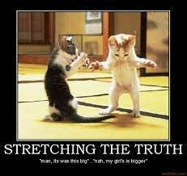
Previous Networking Papers
“I didn’t use FaceBook, LinkedIn”
Only my example in sample rubric Dr. Quinn
Absolutely, use all your resources!
Beware of fabrications
“Couldn’t find her on Google.”
Be advised: I look up stuff
Sometimes I contact a networking target
“Against company policy to provide address.”
Turning social event, meet-up or job interview into networking exercise.
Date stamp is evidence of procrastination

Slide 18
Networking exercise FORMAT
Who do you want to meet?
Why?
Bottom line results
In-person interview, Zoom (if pre-approved)
Date, time, place
How long did conversation last?
Description of your journey. Especially the obstacles you overcame. Did you have to pivot? Rely on e-mail?
What did you discuss with your networking target?
What did you discover? Learn?
Any next steps planned?
Photo evidence – screen shot of you and your target
Photo evidence – screen shot of your thank you note

Slide 19
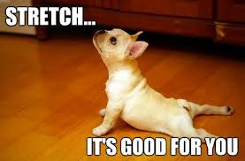
Previous Networking Papers
Eyeball-eyeball conversation required
“Stretch” out of comfort zone
Procrastinate? Pivot, get help
Networking showcase March 13 = CP!
Thank you notes
Handwritten
Invest in quality notepaper (UCSD bookstore)
Evidence of mailing

Slide 20
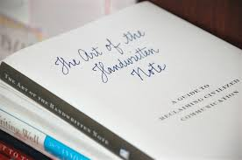

Networking skills
A handwritten note
can trump all!

Slide 21
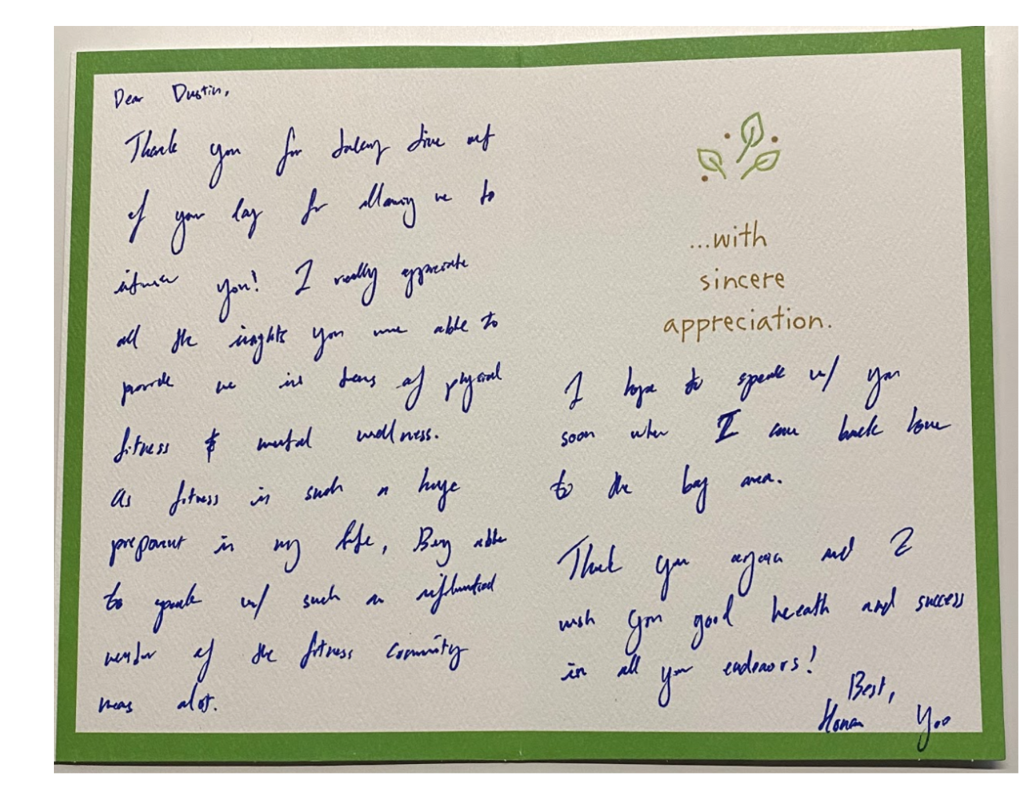
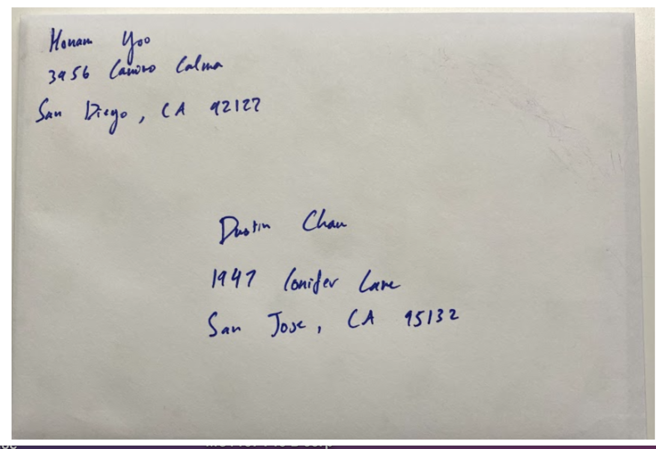
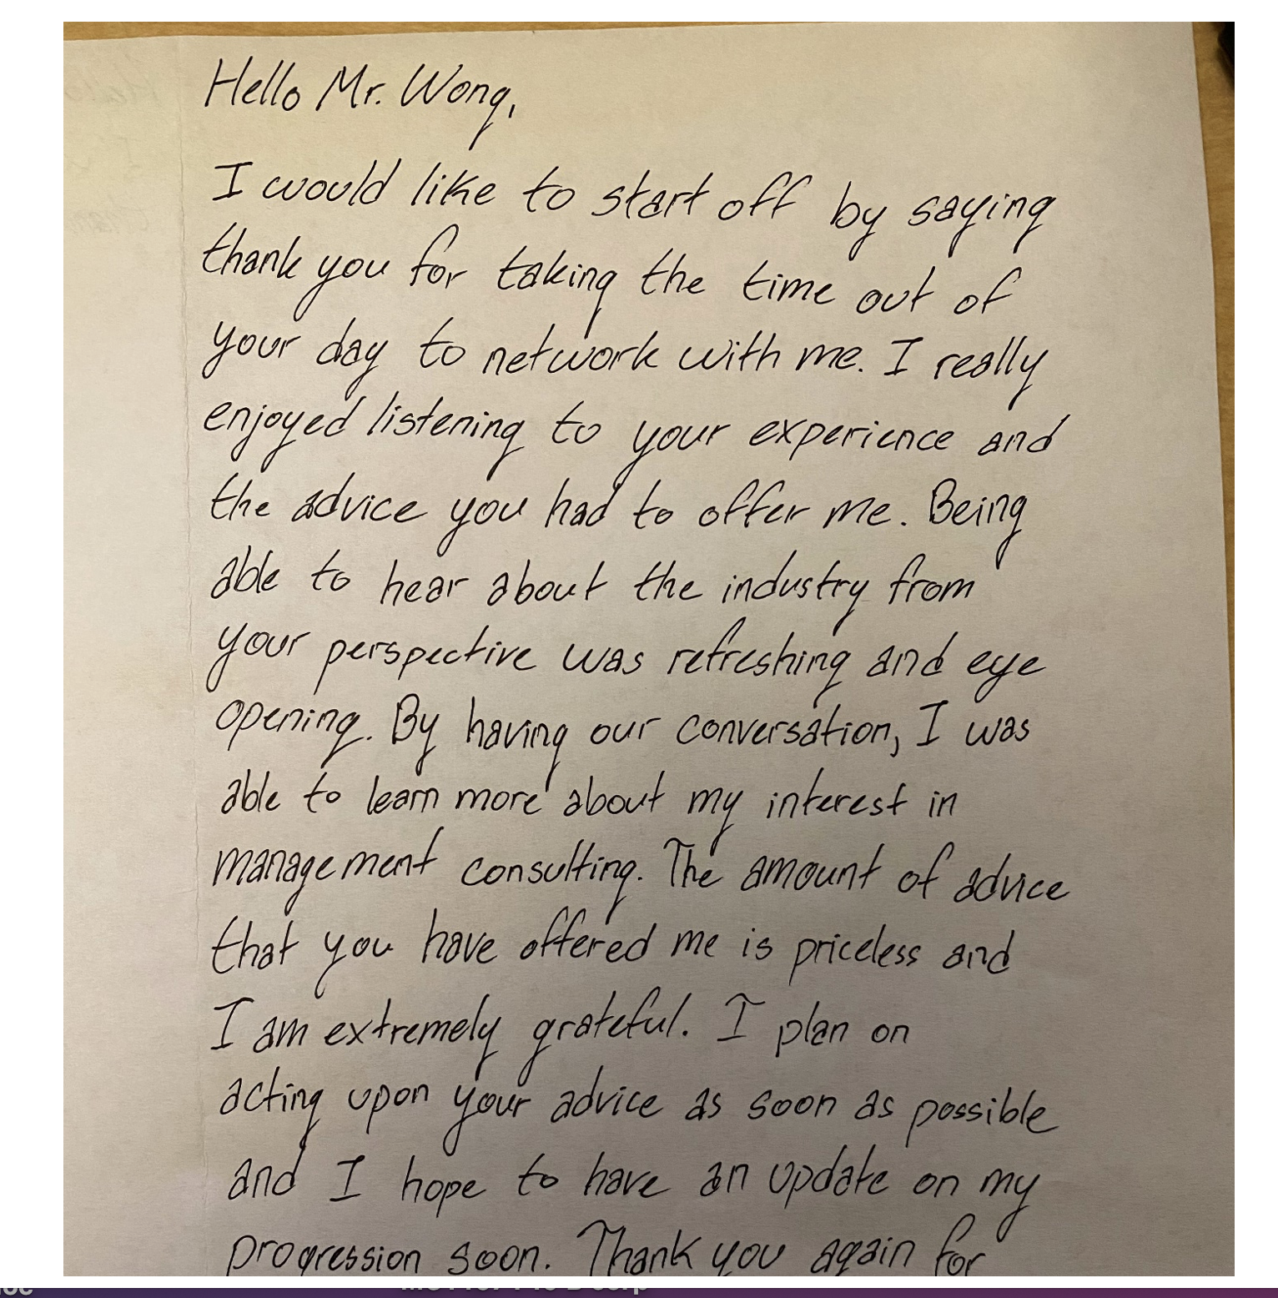
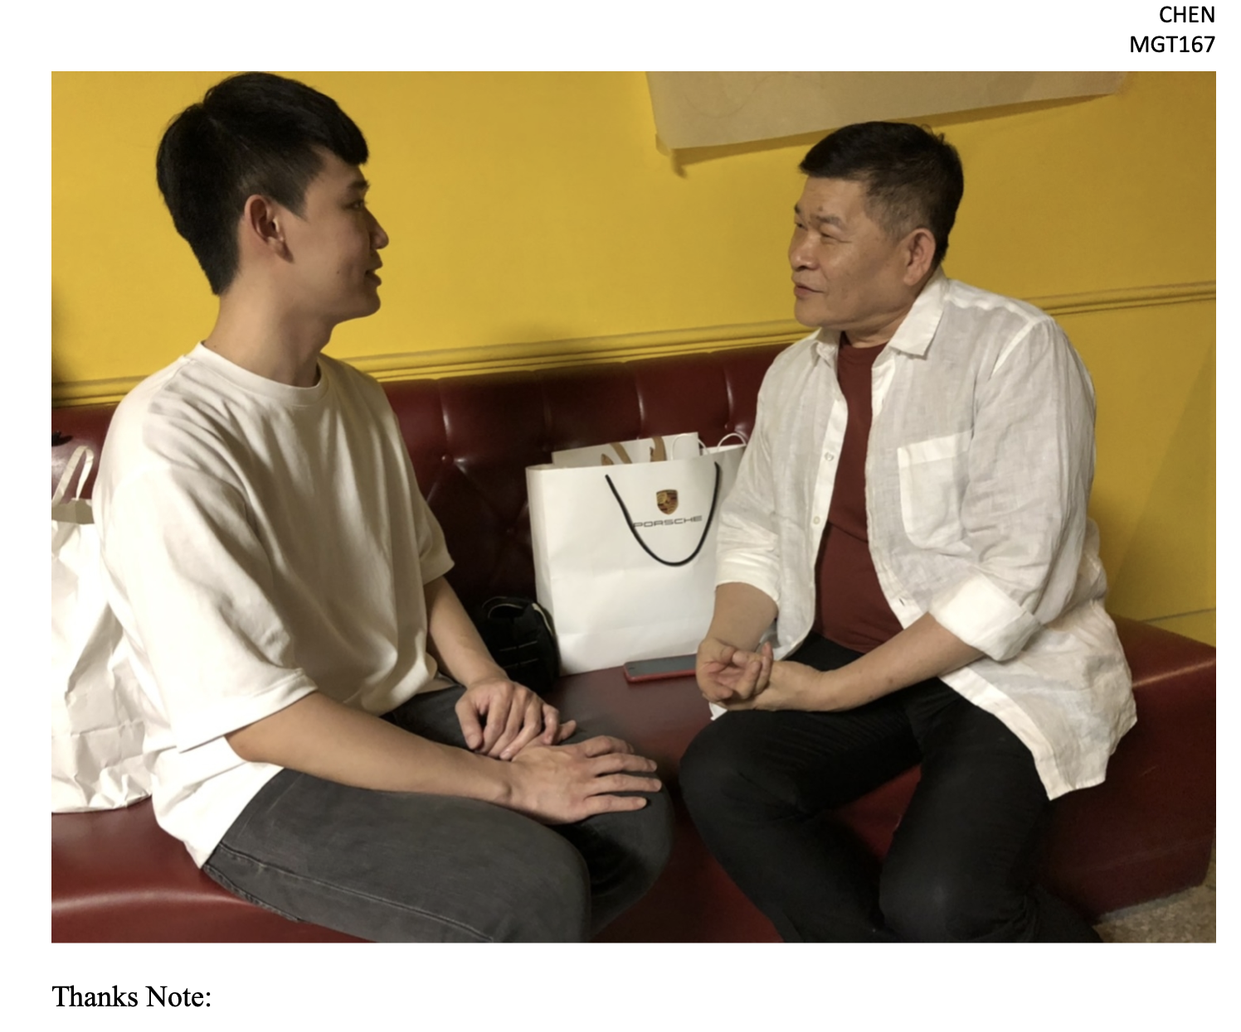

Slide 22

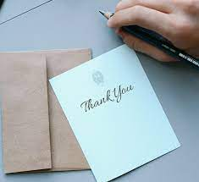
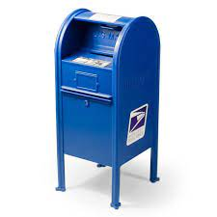
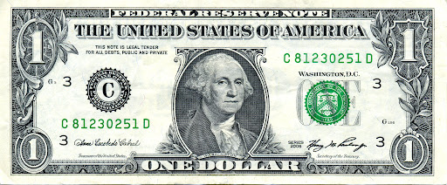

Slide 23

Some advice

Slide 24



Classmates as Resources Professors and TA’s as Resources

Slide 25
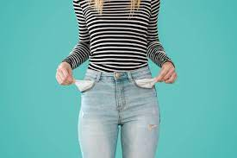
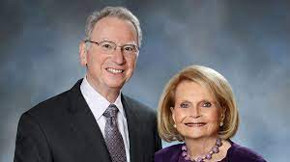
Respecting names makes you memorable
Jacob not Jacobs
Me Them

Slide 26

I want to respect your time…
“I know you are very busy” =
red flag for your own comfort zone.
Lose that from your vocabulary!
Instead, say "I want to respect your time." contract
Be confident that YOU are worth their time.
"I know you are busy" makes it too easy for someone to dismiss you.

Slide 27
Writing style tips Minimize personal pronouns, sincerely compliment, respect their time
I'm a student at UCSD, and I have a course project that involves interviewing someone who I consider interesting/inspirational.
I wanted to reach out to you because I really loved the atmosphere you cultivated for xxxx. I know you're probably very busy, but just a quick call would be huge for me!
Thank you for cultivating positive change through mental health awareness. As a global health major at UC San Diego, I find your work at XXXXX highly interesting and inspirational. It would be a great honor to learn more from you and write about XXXX in my senior thesis-term paper.
I will respect your time. Would you consider a 20-minute office visit, at your convenience, sometime (suggest date)? Thank you for your consideration.
-Name, contact info, photo

Slide 28


Purpose Beyond Profit 2 case studies

Slide 29


Slide 30
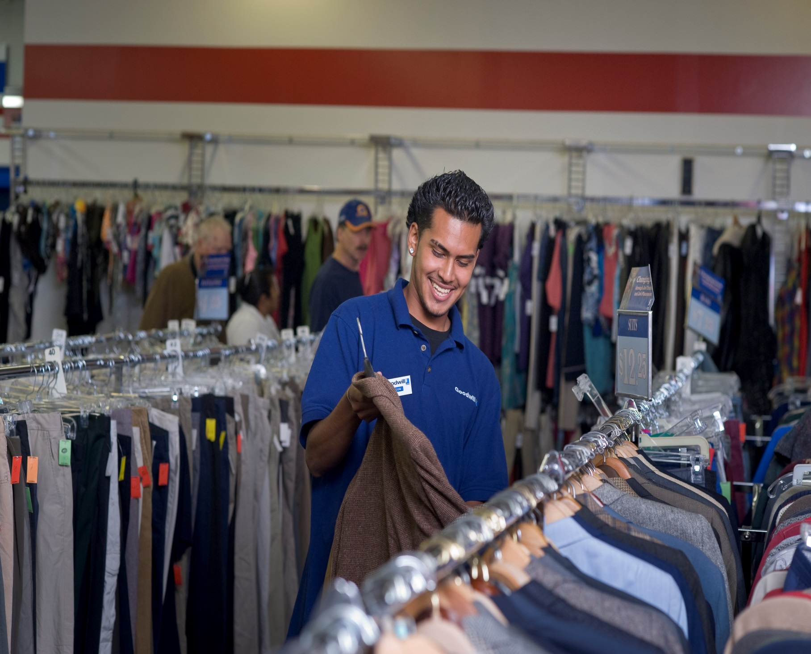
Goodwill gives people jobs

Slide 31

Goodwill Industries 501(c)(3)
Founded by Methodist Minister Rev. Helms
Boston 1902
Proud European immigrants didn’t want handouts; they wanted to work
Early recycling model
Sheltered workshops
Now 4,245 Goodwill stores
“Magic of Work” gives purpose to life

Slide 32
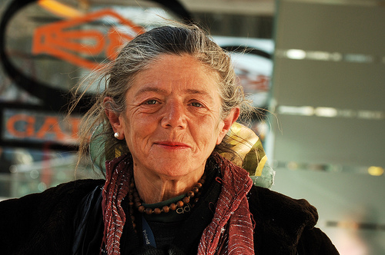
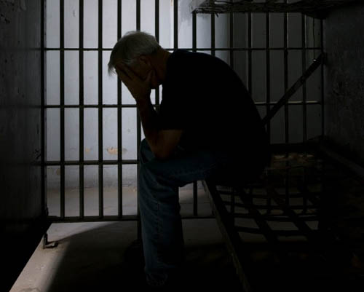
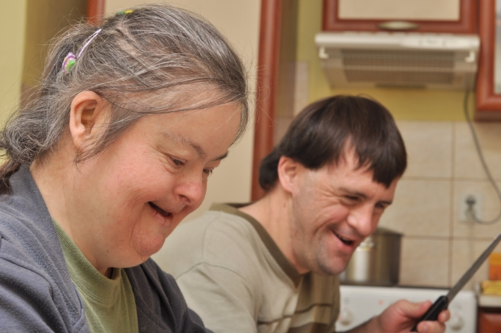
“I was a beautiful chick and now I’m old…
no one wants me.”
Barriers to
employment

Slide 33

Goodwill Industries
94% revenue is sale of used goods
No fundraising
Revenue: $7.4 Billion (2022)
Local Goodwill = $62 M (Evergreen Seattle $113 M)
Minimum wage issues
Labor and space intensive
Culture of Goodwill: “This is my family”
Marketing: “Goodwill is the NORDSTROM of Thrift stores”
Competition for Goodwill is FOR PROFIT Thrifts
Value Village, Savers
Misleading claims create impression they are charities
Do your research before you donate!

Slide 34
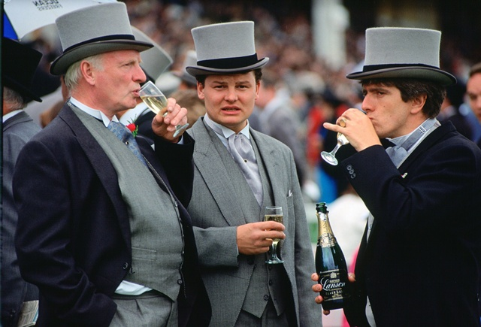
Take the item from the Wealthy…

Slide 35
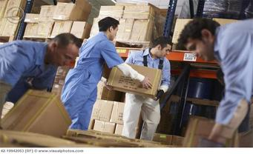
Employ the Poor…

Slide 36
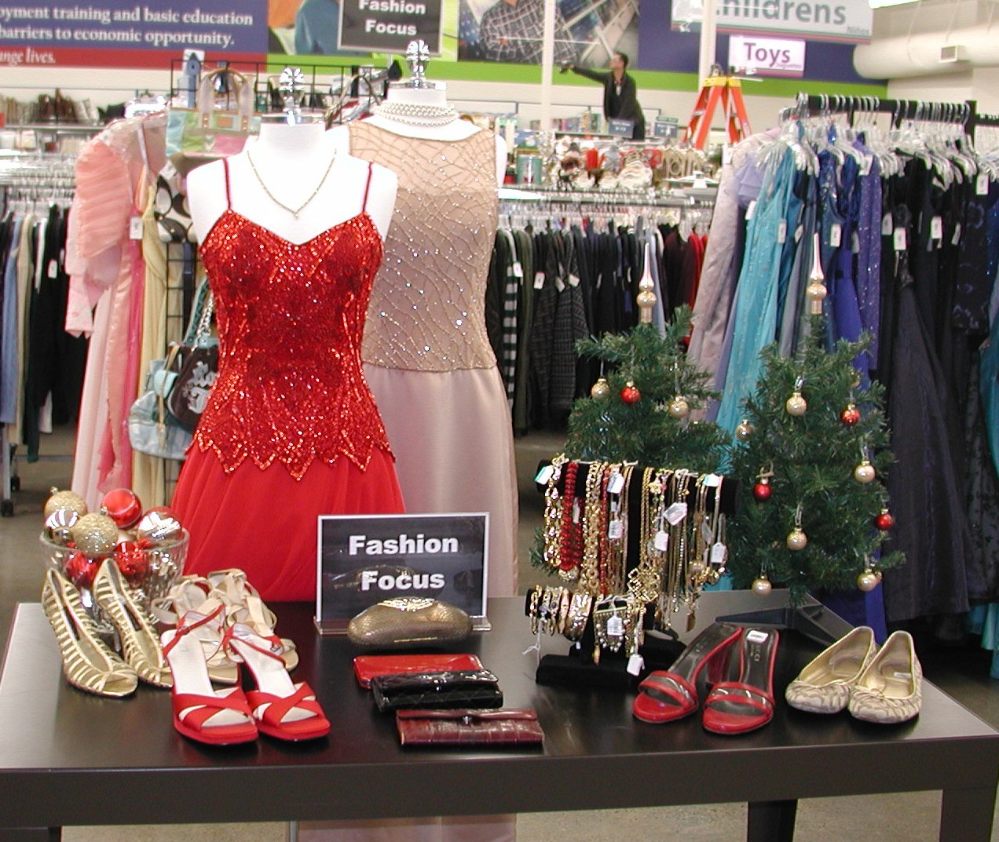
Sell it to the Middle Class

Slide 37
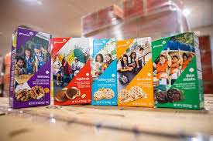
Drawing for Girl Scout Cookies

Slide 38


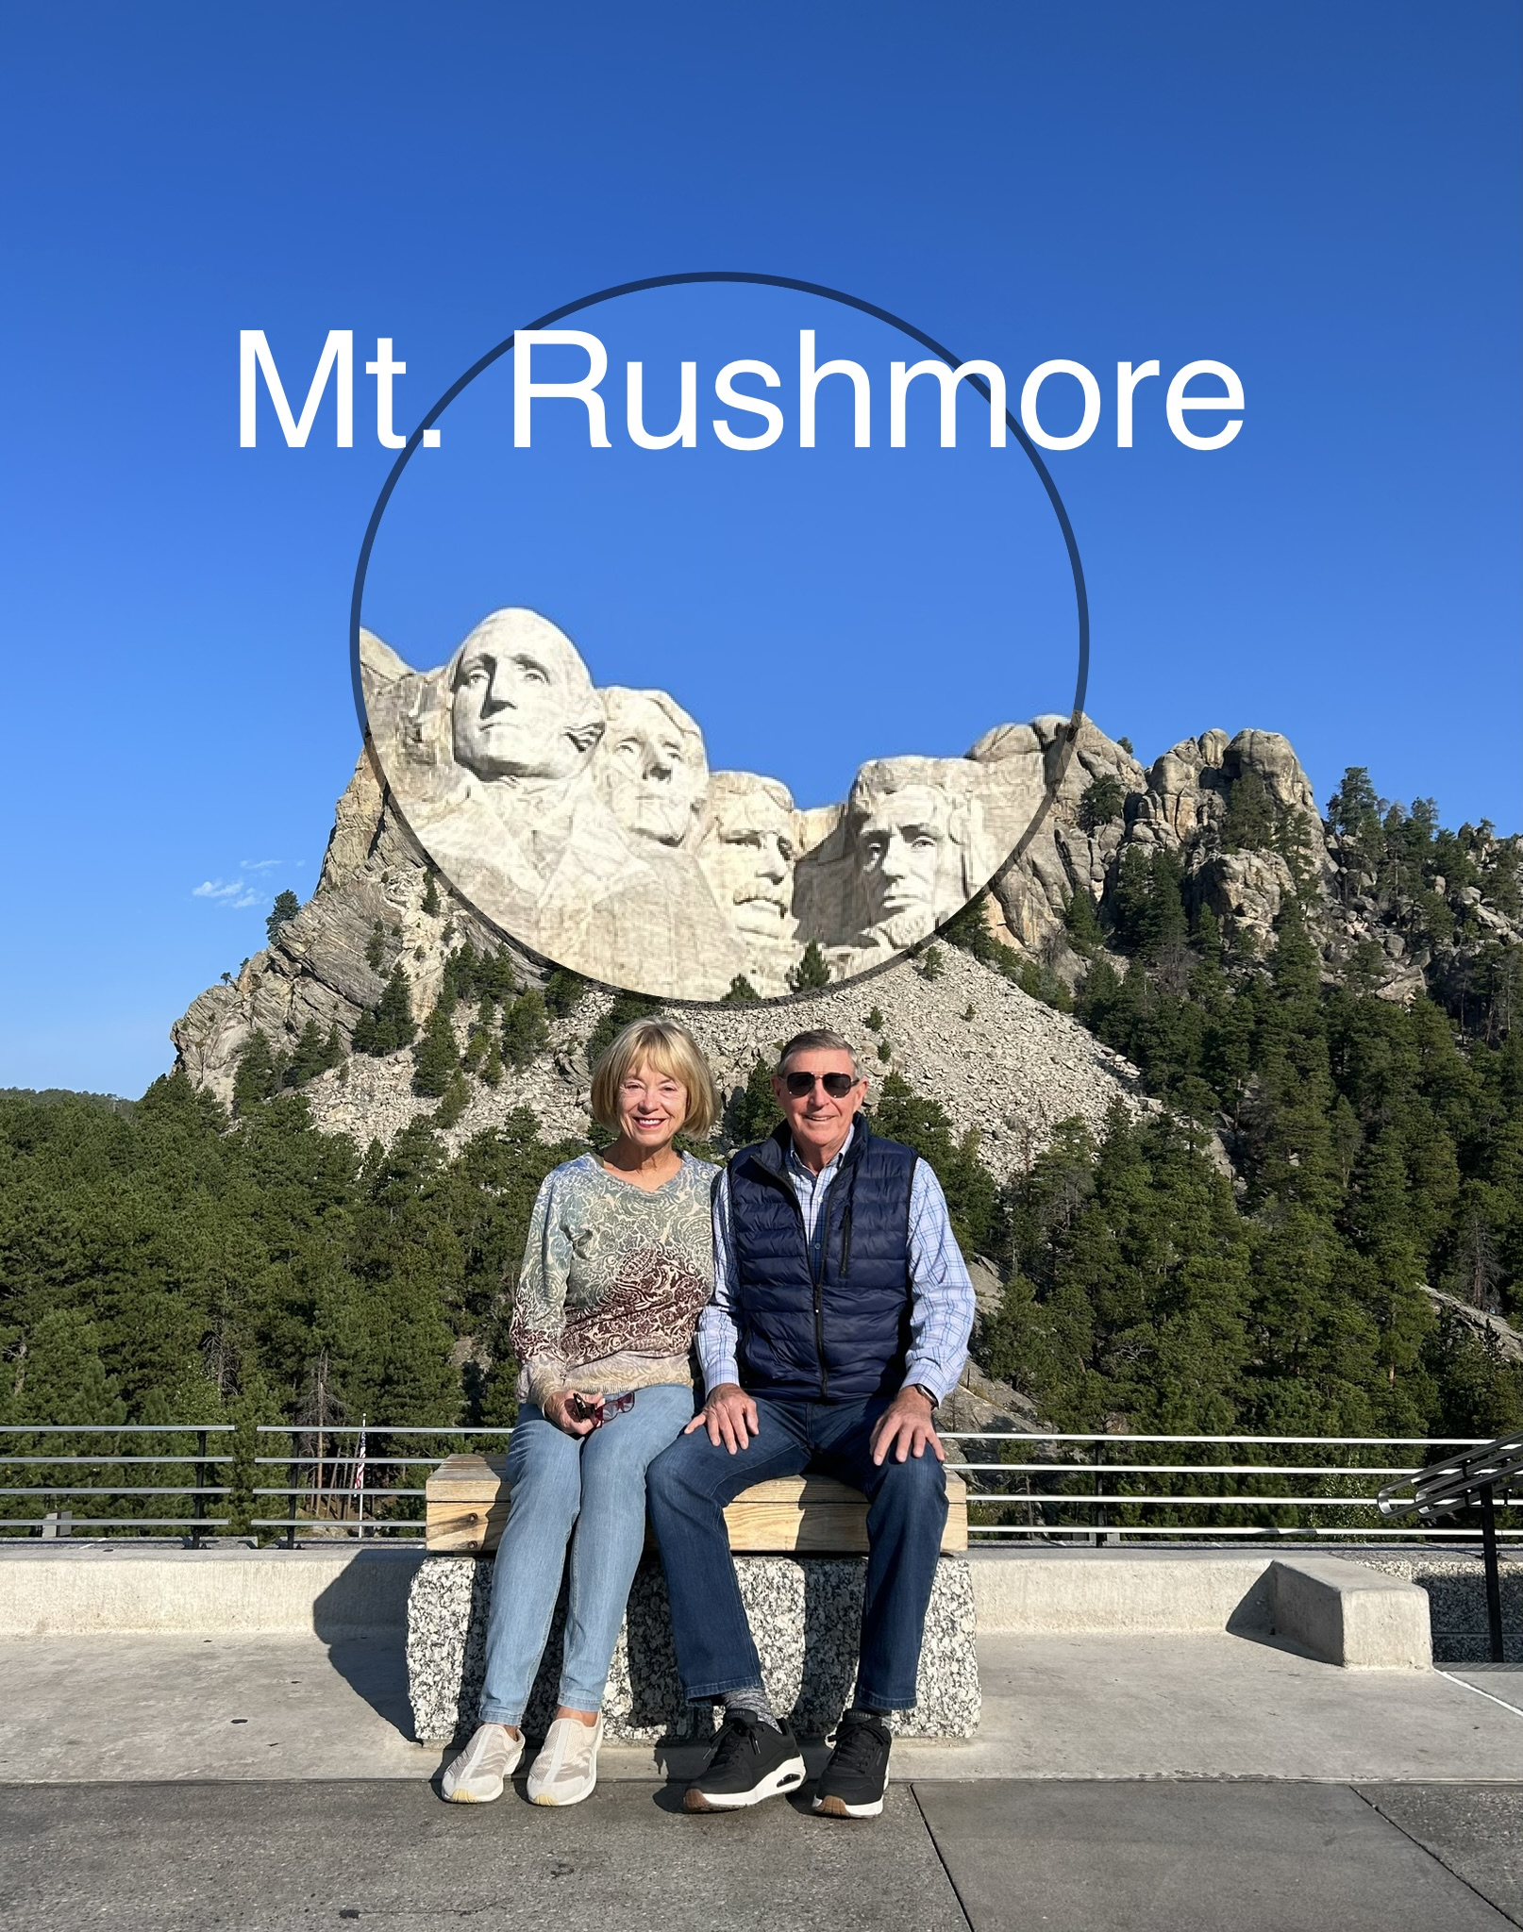

No class Monday, February 19
Quiz #3 due 11 am Wednesday, 21 Feb.
Happy Valentine’s Day!
Stay Safe this weekend…

